Slide 1

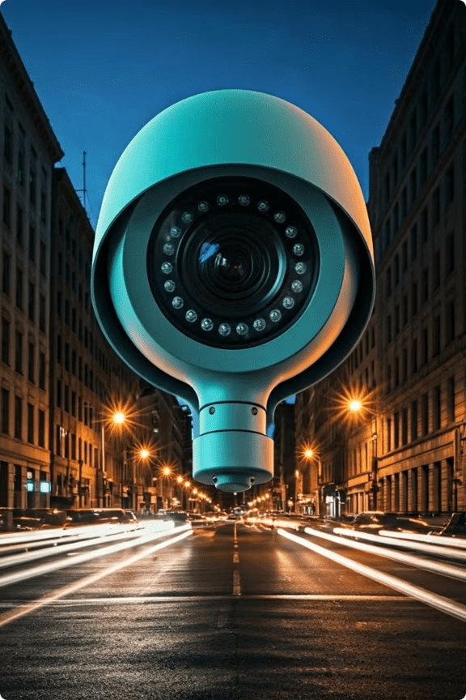
Facial Reconstruction from Low-Quality CCTV Footage
Team Name : TEAM NEBULA
Names of Team Members
JUPITER
SUKHESH RAM
JOELRAJ
MANIMARAN

Slide 2
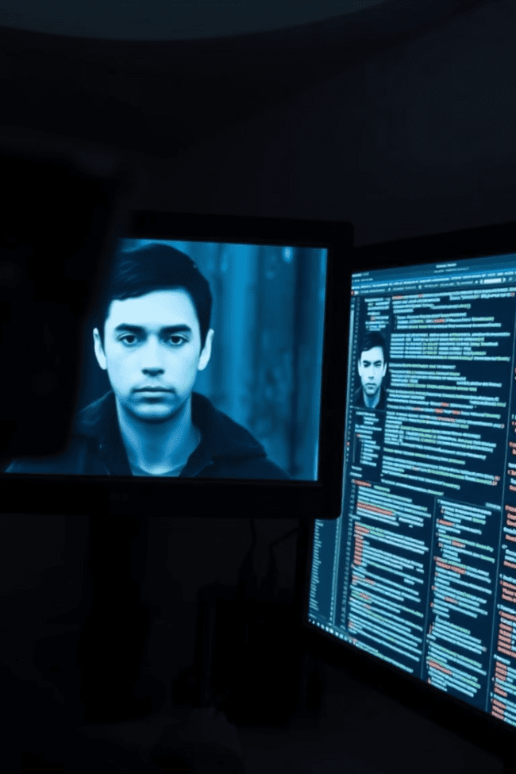
Challenge Overview
The challenge is to develop an advanced machine learning solution capable of reconstructing human faces from low-quality CCTV footage. The goal is to enhance blurry or distorted images using state-of-the-art computer vision techniques, helping investigators identify suspects with greater accuracy. This project encourages participants to solve real-world security and surveillance issues by addressing key challenges such as motion blur, poor lighting, and low resolution.

Slide 3
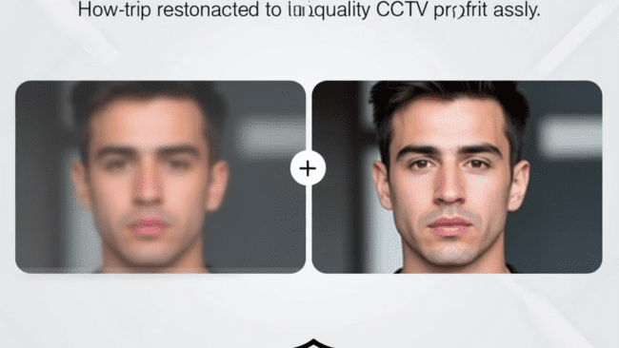
Objectives
The objective of a project refers to its primary goal or purpose. In this case, the objective is to create a solution that can improve the quality of blurry or low-resolution images from CCTV footage, making it easier to identify people. Essentially, it's about enhancing poor-quality images using machine learning, especially in scenarios like security and surveillance, to assist in more accurate identification.

Slide 4
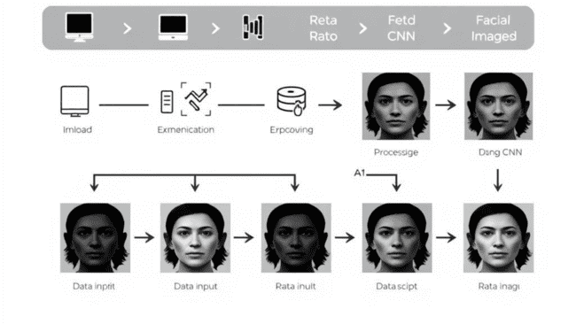
Methodology Overview
Model Setup: Utilize the GFPGAN (Generative Facial Prior GAN) for facial reconstruction and enhancement.
Image Preprocessing: Upload low-quality images, performing noise reduction and resizing for better input quality.
Inference Process: Apply GFPGAN to enhance facial details, improving clarity and brightness through deep learning techniques.
Enhancement Techniques: Implement super-resolution, deblurring, and noise reduction to improve overall image quality.
Results Comparison: Display enhanced images alongside original ones to showcase improvements, saving outputs for evaluation.

Slide 5
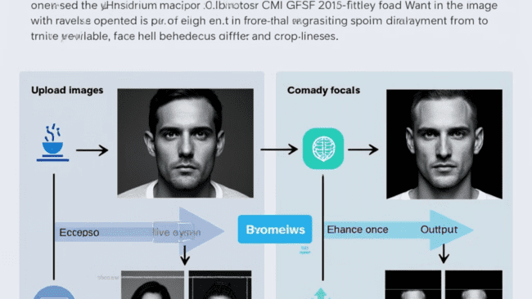
Model Architecture
Framework and Dependencies:
PyTorch: Utilized for deep learning; compatible versions are installed for smooth execution.
GFPGAN: Employs a generator and discriminator tailored for facial enhancement.
Model Components:
Generator:
Transforms low-resolution images into high-quality outputs using Convolutional Neural Networks (CNNs) to capture facial features and textures.
Discriminator:
Assesses the quality of generated images, providing feedback to refine the generator’s outputs.

Slide 6
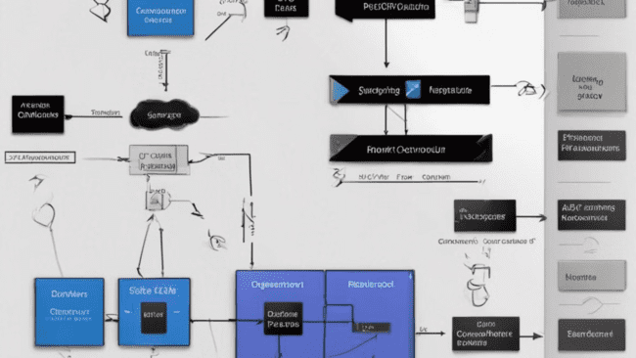
Model Architecture
Image Processing Techniques:
Super-Resolution: Upscales images to recover details from low-resolution inputs.
Deblurring: Reduces motion blur for clearer images under challenging conditions.
Inference Pipeline:
Begins with uploading low-quality images to GFPGAN, which processes the input through the generator for enhanced output.
Visualization:
Compares input and output images, ensuring the model's functionality through output verification.
Real-Time Processing:
Designed for rapid image enhancement, making it suitable for surveillance and security applications.

Slide 7
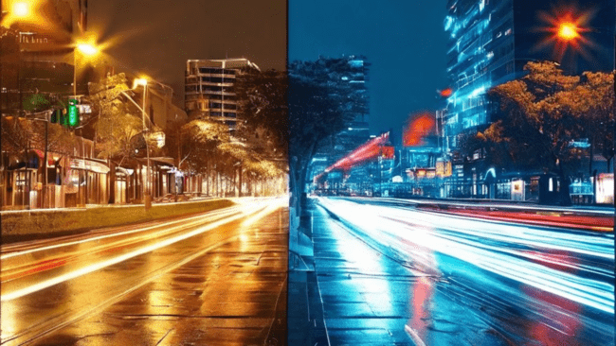
Key Challenges and Solutions
The primary challenges in this project include motion blur, low resolution, and poor lighting conditions, which can significantly degrade the quality of CCTV footage. The team has implemented solutions such as noise reduction and super-resolution to address these issues and improve the input quality for the GFPGAN model.
1
Motion Blur
2
Low Resolution
3
Poor Lighting
Utilize advanced deblurring techniques to sharpen the images.
Apply super-resolution algorithms to upscale the input footage.
Enhance the image contrast and luminance to compensate for low-light conditions.

Slide 8
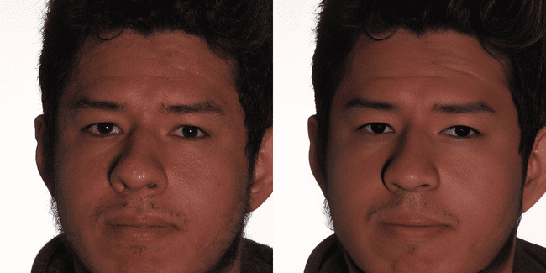
Results
The GFPGAN-based facial reconstruction model has demonstrated significant improvements in image clarity and detail when compared to the original low-quality CCTV footage. The enhanced images provide clearer facial features, enabling better identification and security applications.
Before and After
The original CCTV footage is blurry and low-resolution, while the enhanced output displays sharp facial features and restored details.

Slide 9
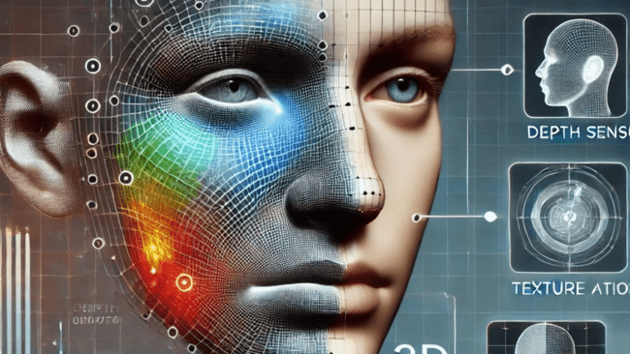
Future Enhancements
3D Reconstruction Overview
Significance:
Enhanced Accuracy: Provides a detailed and realistic representation of facial features.
Lifelike Models: Captures depth information for improved realism in applications like VR and animation.
Methodology:
Depth Sensing: Use stereo vision or structured light to gather depth data.
Mesh Generation: Create a 3D mesh using depth information, defining vertices and edges.
Texture Mapping: Apply 2D textures to enhance realism on the 3D model.
Facial Feature Detection: Utilize machine learning to identify key facial landmarks for better accuracy.
Real-Time Processing: Optimize for immediate feedback in applications like security and entertainment.
By integrating 3D reconstruction, the system enhances facial analysis capabilities and opens new avenues for innovation.

Slide 10
Results and Findings
The project has yielded promising results in the field of facial reconstruction from low-quality CCTV footage. The team's efforts have demonstrated the effectiveness of the GFPGAN model in enhancing image clarity and restoring facial details, paving the way for improved security applications.

Slide 11
Conclusion
In conclusion, the project successfully demonstrated the capability of the GFPGAN model to enhance facial images from low-quality sources. By applying advanced super-resolution and image restoration techniques, the model proved effective in improving image clarity, making it a valuable tool for security and surveillance applications. The findings suggest a significant potential for future developments in image processing and facial reconstruction, contributing to more reliable identification systems.

